Slide 1
What’s out there?

Slide 2
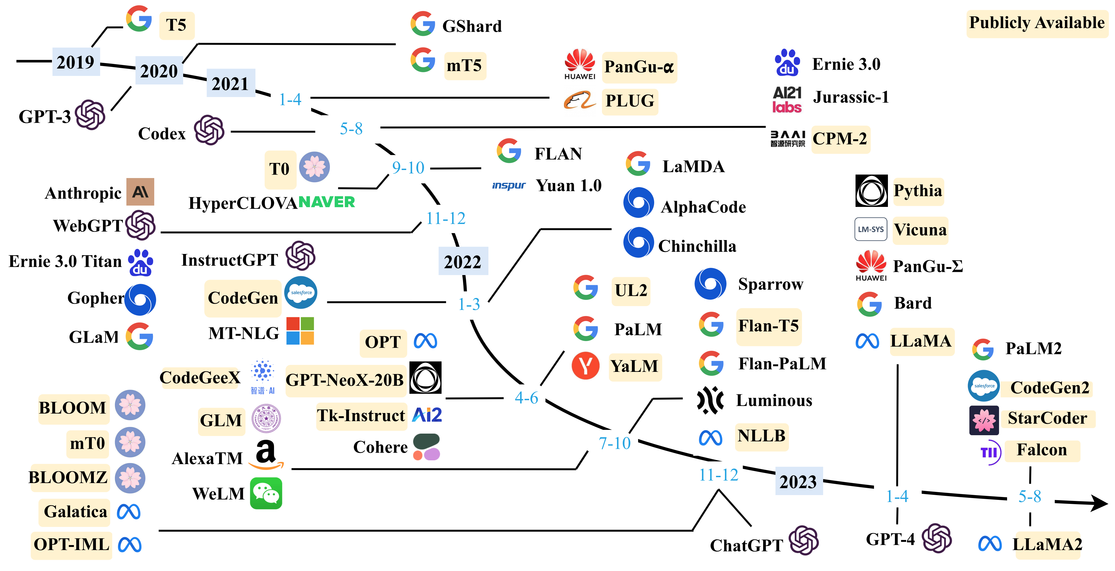
Timeline of >10B parameter models
Notes:
There are so many different models out there, coming out so quickly, that it can be very challenging to keep track of them all. For example, here is an overview of just a small subset of the >10B parameter models!

Slide 3
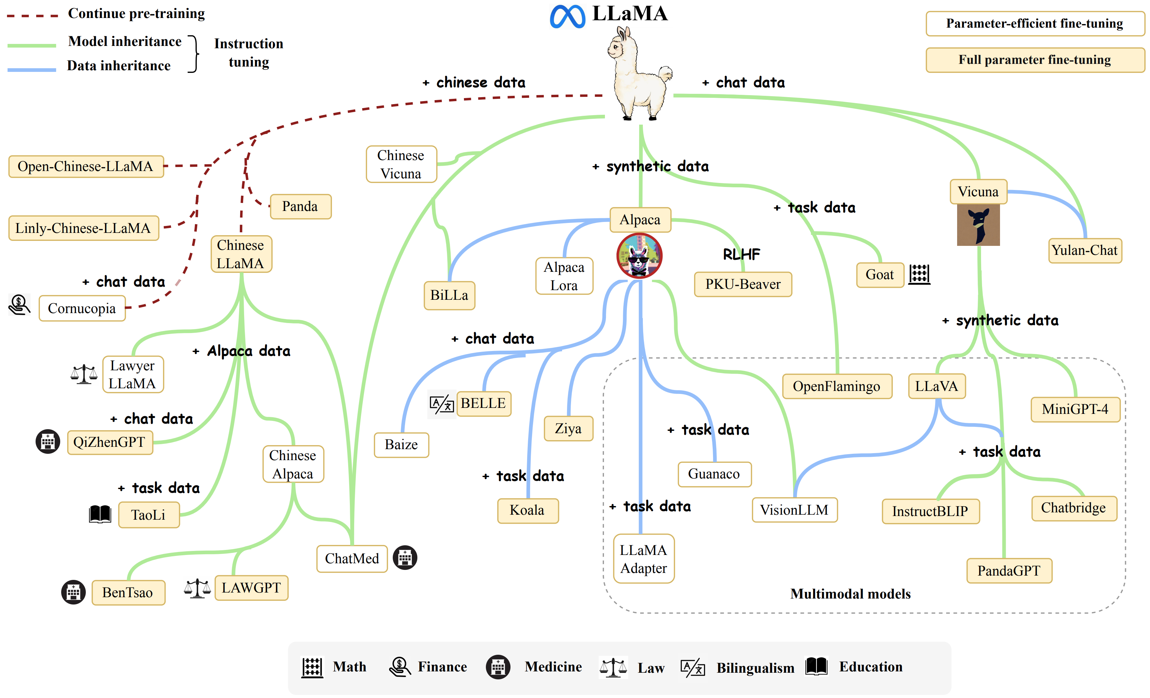
How can we categorize LLMs?
Architecture
Objective or use-case
Scale
Modalities
Language
Availability
Sometimes, one base model can evolve into all of the above!
Notes:
It can be challenging to subdivide LLMs:
Architecture type:
Autoregressive models such as GPT (generative models that perform next token prediction)
Encoders like BERT (reconstruct parts of a sentence)
Seq2seq like T5 or BART (transform the input sequence to an output sequence)
Objective and use-cases:
Language modelling vs masked language modelling
Multitask such as T5
Specialized models that might be fine-tuned - so separating GPT-3 from GPT-3+RAG or GPT-3+fine-tuned.
Scale:
Small to medium models
Chungus models (> 70B parameters)
Modalities:
You might have heard of GPT-4 as being multi-modal - it can process text and images.
Some models are “less” multimodal than others and are trained for specific purposes such as image captioning. Compare this to GPT-4.
Language support:
Monolingual
Multilingual
Availability:
Open source (so you can either download the weights and run locally, or run via an API).
Closed source (model architecture, weights, and/or training data is kept private, and can only be accessed via an API).
Sometimes one base generative model can evolve into all of the above! Llama for example.

Slide 4
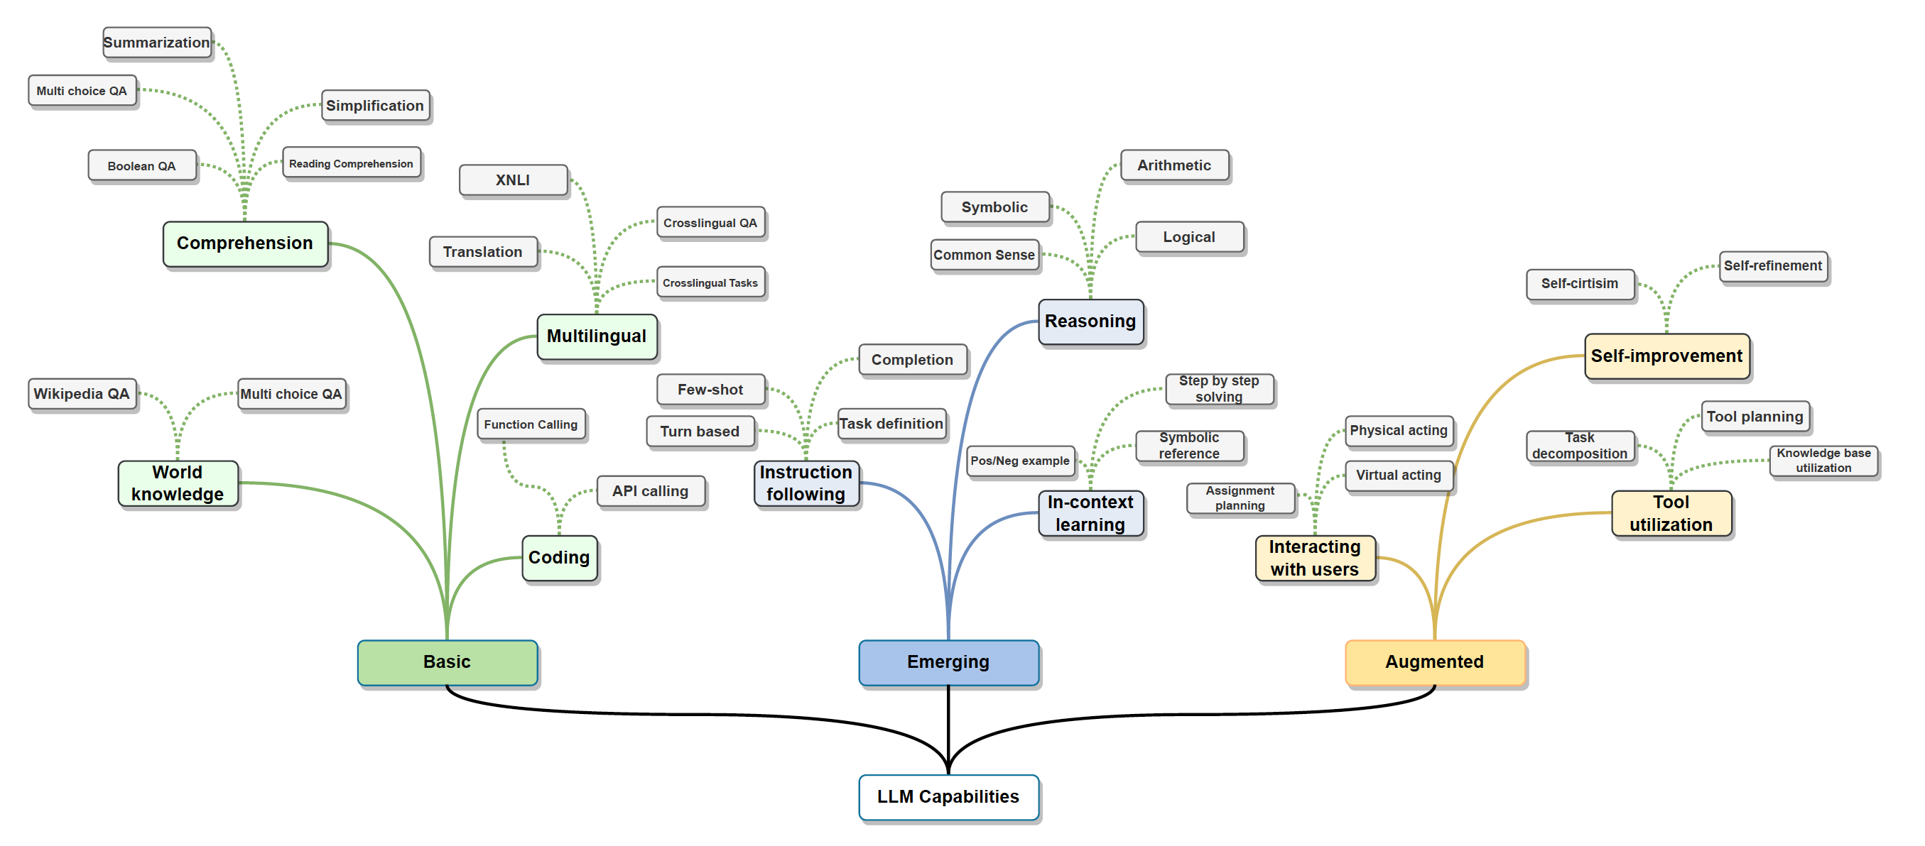
How can we categorize LLMs?
Notes:
One way of categorizing models would be by capability

Slide 5
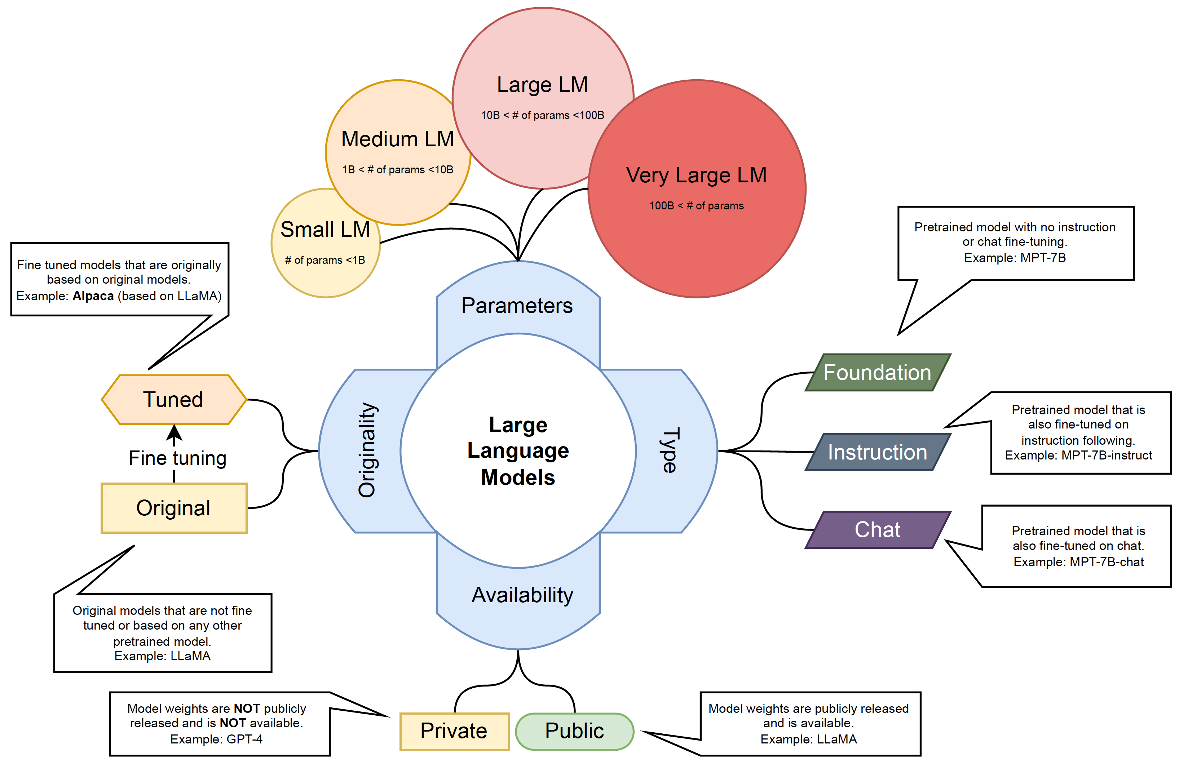
How can we categorize LLMs?
Notes:
There are so many different models out there, coming out so quickly, that it can be very challenging to keep track of them all. For example, here is an overview of just a small subset of the >10B parameter models!

Slide 6
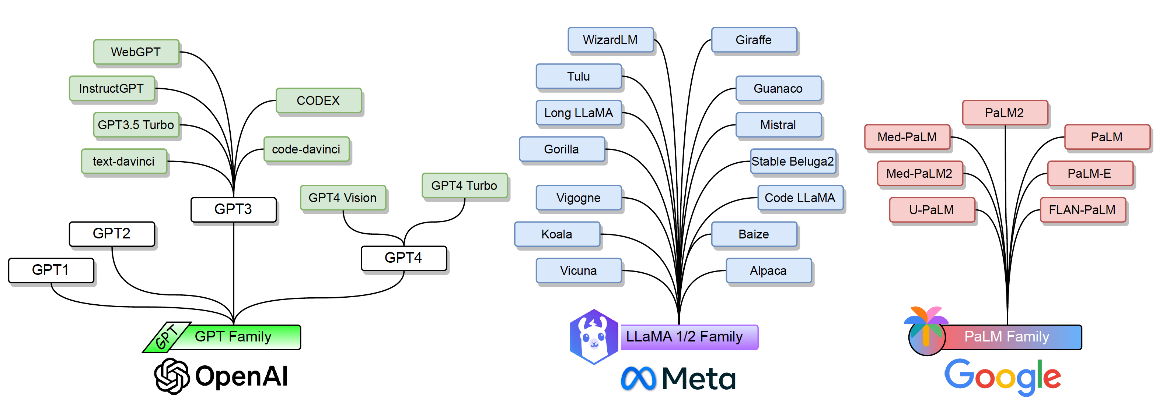
Popular LLM Families
Notes:
There are so many different models out there, coming out so quickly, that it can be very challenging to keep track of them all. For example, here is an overview of just a small subset of the >10B parameter models!

Slide 7
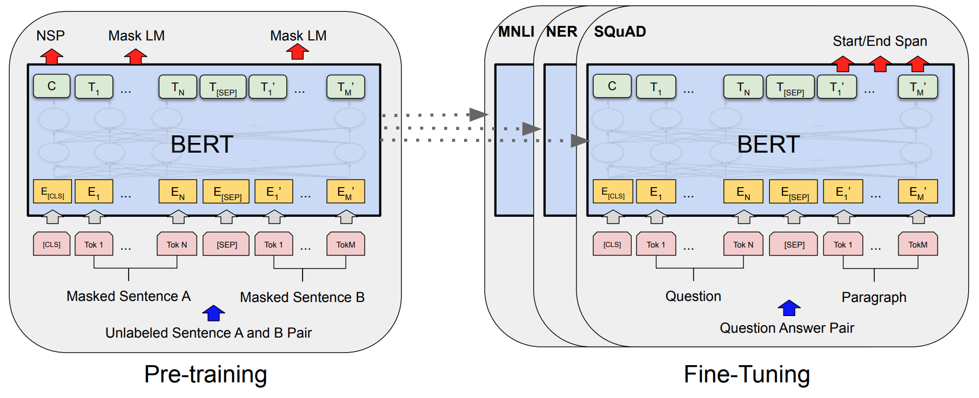
BERT
Bidirectional Encoder Representations from Transformers
Notes:
BERT is an “encoder-only” model, trained on 2 tasks simultaneously: masked token prediction, and question answer pairs.
This is in stark contrast to the GPT-style models that we have seen, which is primarily NEXT token prediction. This makes BERT incredibly versatile.
First notice the input and output shapes – you get the same number of outputs as you do inputs. This means that each output actually encodes contextual information about the inputs. You can see here that BERT includes “special” tokens [CLS] and [SEP]. And these special tokens encode general contextual information about the entire input context.

Slide 8
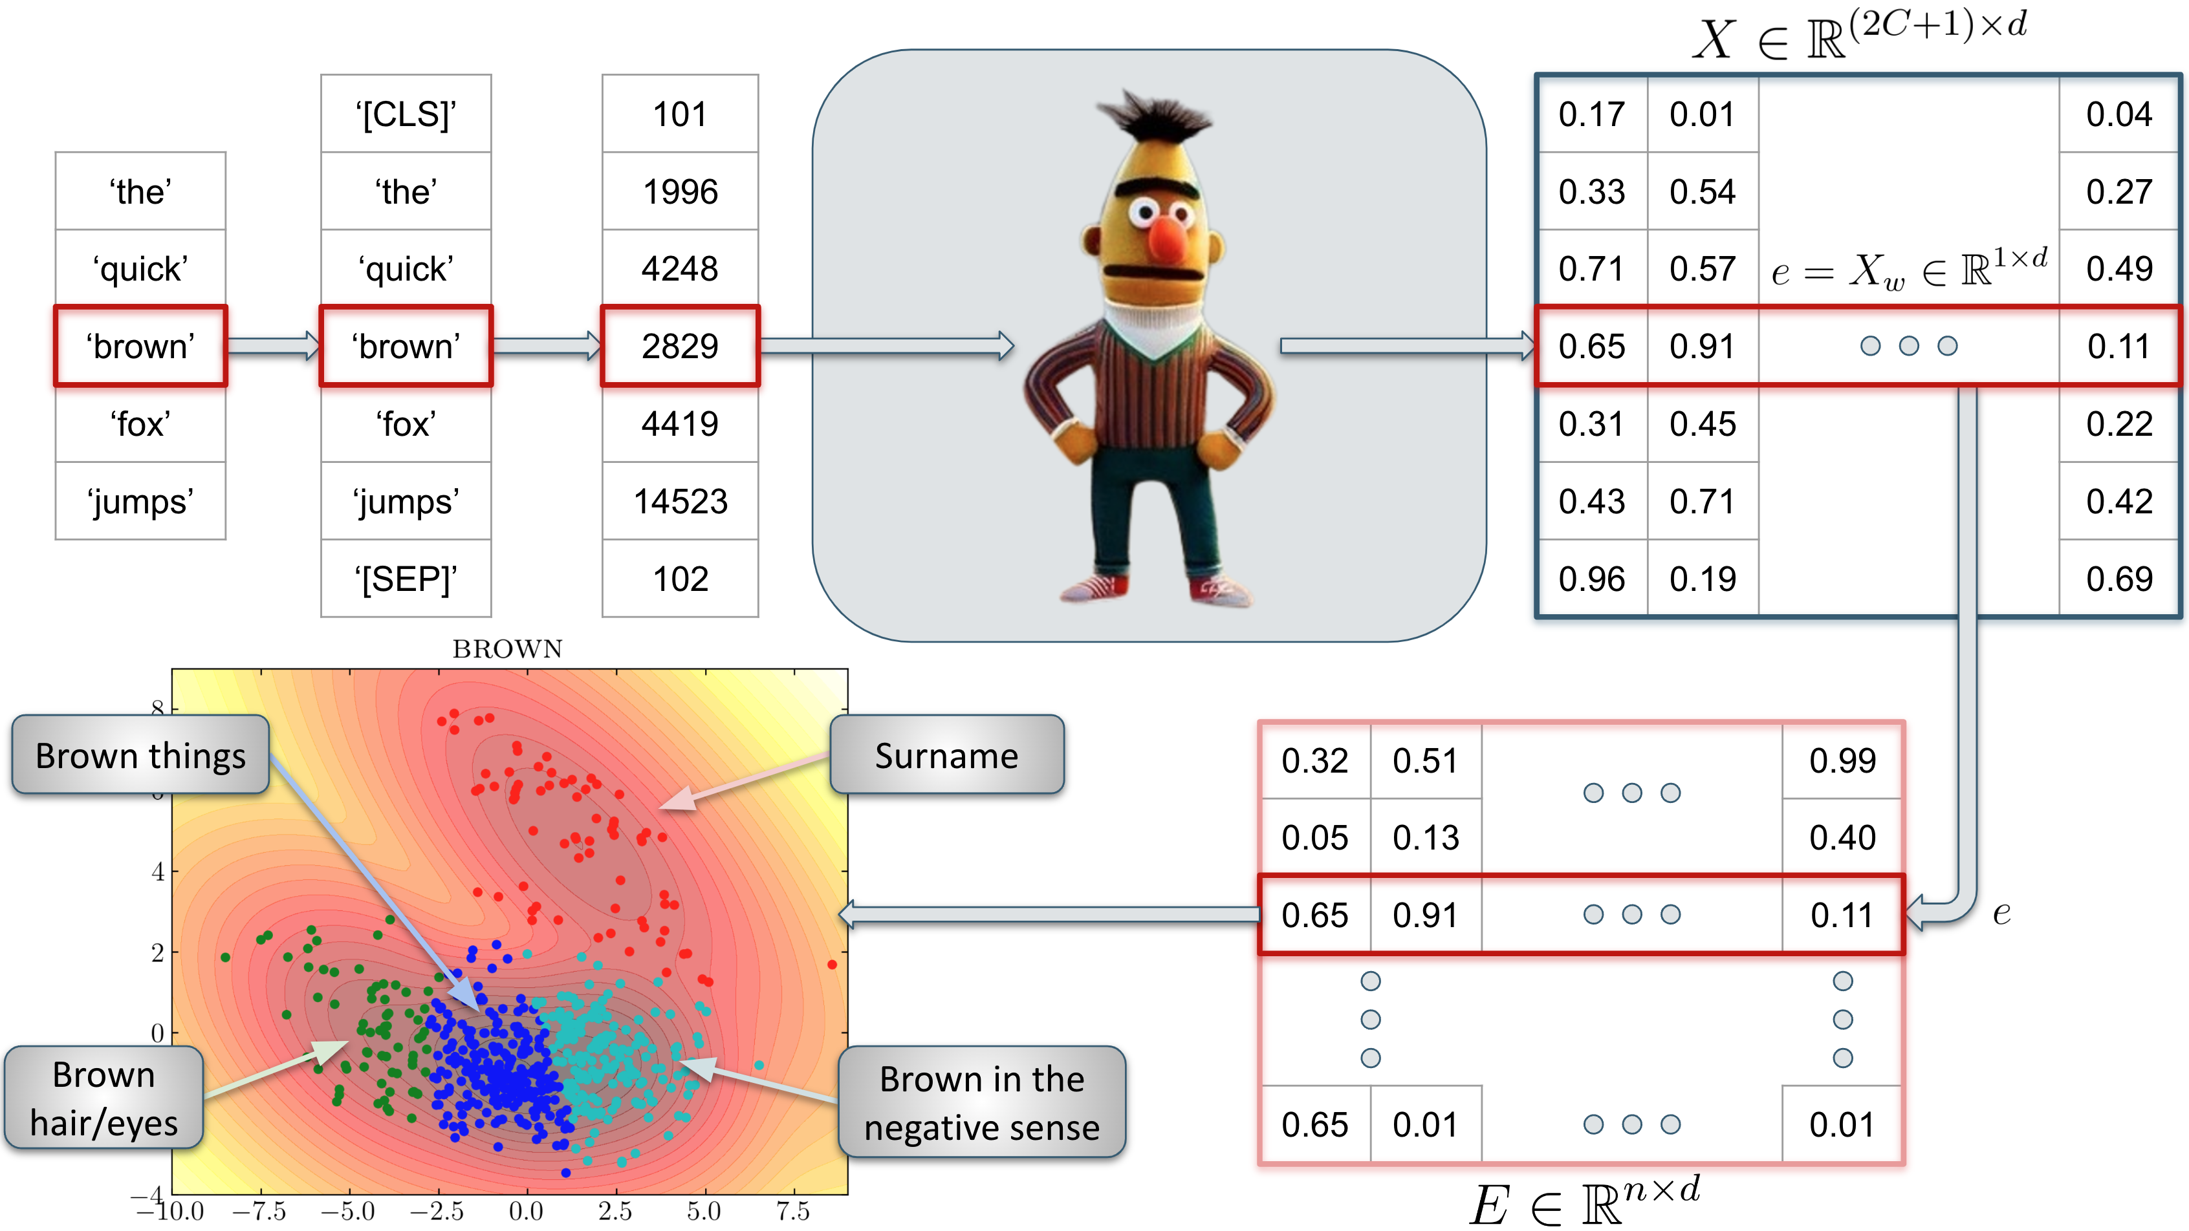
Haket and Daniels, “BERT’s Conceptual Cartography: Mapping the Landscapes of Meaning.” EMNLP2024, under review

Slide 9

BERT
BERT is a very versatile family
DistilBERT
CamemBERT
ERNIE
XML-RoBERTa
RoBERTa
ALBERT
BART
Q-BERT

Slide 10
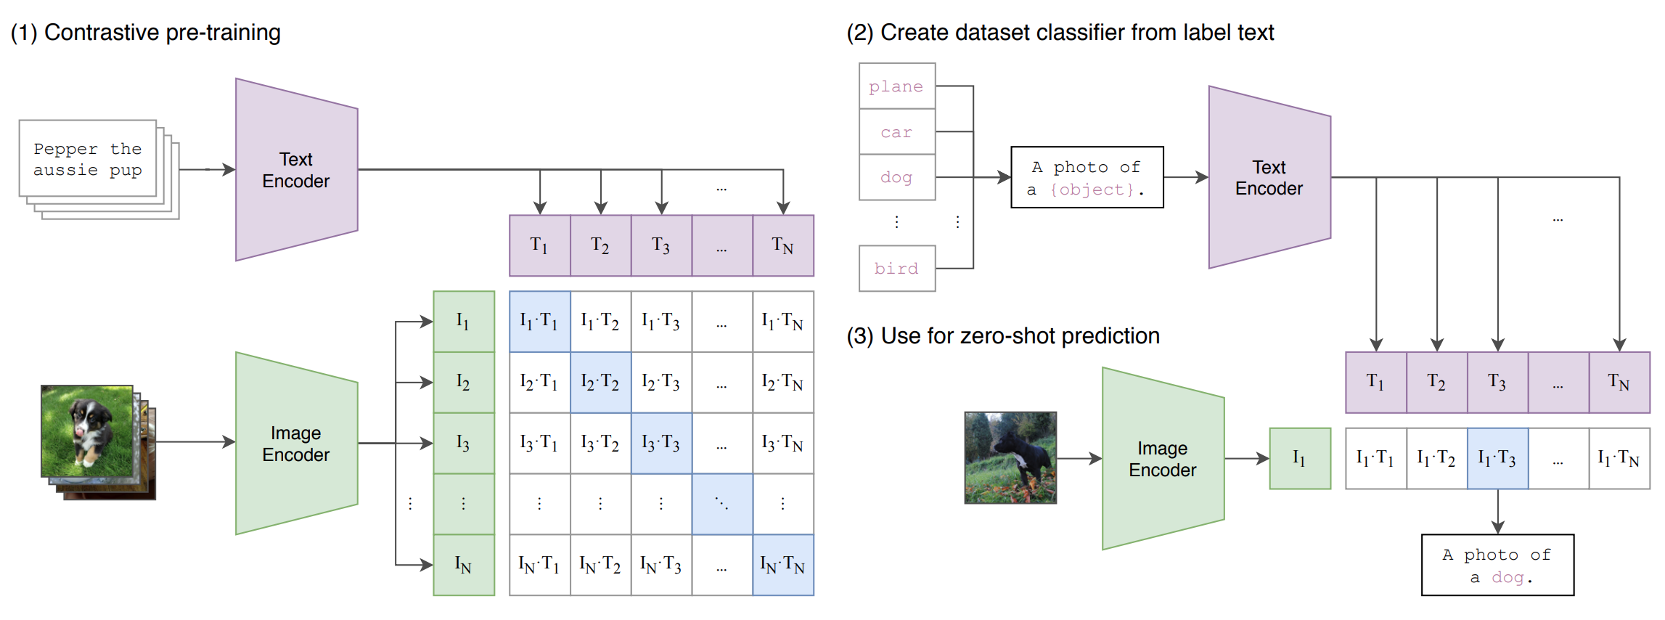
CLIP
Contrastive Language-Image Pre-training
Learning Transferable Visual Models for Natural Language Supervision, Radford et al, 2021, ~17k citations
Takes in images and texts and connects them together
Radford, Alec, et al. "Learning transferable visual models from natural language supervision." International conference on machine learning. PMLR, 2021.
Notes:
Scrape a bunch of photos (400m to be precise) and the accompanying text. Ask the question: How likely does a piece of text go with an image?
The prompt becomes important.
Take an image, and pass it through an encoder which will produce a vector in latent space. We do this for every image in a batch.
Take the text corresponding to the image and pass it through a different decoder which will produce another vector in latent space.
Now ask the model, which of the text is most appropriate for each image.
In training we are trying to maximize the cosine similarity between correct image-caption vector pairs, and simultaneously minimize the similarity scores between all incorrect pairs.
When running in inference mode, we are calculating the similarity scores between the vector of a single image with all possible caption vectors.
In our code, the batch size, and therefore the similarity matrix, is quite small. For CLIP, the similarity matrix is 20,000 x 20,000! This is a huge batch.
The contrastive loss function can be tricky to wrap your head around.
We take a single image embedding.
Find the cosine similarity between that embedding and the embedding of every text label.
Take the similarities and apply a softmax function to find a probability distribution over the text labels.
This tells you how likely does this image correspond to the possible text embeddings.
And then you do this for every image.
…And then do it for the text labels.
Take the average of these two losses.
CLIP did a few novel things:
Scraping text/image pairs
Efficient training on large batches
Zero-shot classification of images
Contrastive loss function

Slide 11



How are companies updating their models?
2017
2018
2019
2020
2022
2023
2024
TRANSFORMER MODEL
Phi-1
Phi-1.5
Phi-2
Phi-3
Llama
Llama-2
Llama-3
GPT-1
GPT-2
GPT-3
GPT-3.5
GPT-4
GPT-4o
Notes:
How do you run OS models?
In order to leverage the full power of an unquantized LLM, you need a graphics processing unit, or GPU. Your computer will have two types of computer in it – the CPU and the GPU. In a video game for example, the CPU is responsible for executing game logic, managing AI, some of the physics calculations, audio processing. The GPU is responsible for ensuring that your game looks amazing. Graphics rendering is essentially complicated linear algebra, so people have developed purpose built chips that are very good at linear algebra. And what is deep learning…? It is again, just complicated linear algebra.
Local LLMs can require vast memory and compute resources. It is possible to locally run smaller models like BERT or nano-GPT on something like a Macbook M1. However, in order to use larger models, or even run smaller ones with low inference latency, a high-end GPU is required with associated memory. Google Colab is one option, but you’re at the mercy of GPU availability, very limited memory, and the seemingly random nature of Colab connections.
If you have access to a GPU then you can download the model and weights locally via Hugging Face and interact with it using the transformers library.
Alternatively, you can use a cloud provider such as AWS, and some services such as AWS Sagemaker have some models for inference readily available. However, running inference on Llama2-7b (which is the smallest model available), will cost you about 1.50USD/hr if you leave it running!
Hugging Face does offer an API to run inference on models, but your access will be quite limited. There is the option of paying for Pro access which has higher rate limits.
Do you need to be able to code in order to interact with and train LLMs? What about hardware?
So how can you get access to a GPU?
- Google Colab
- Cloud
- Buy one
- Your departmental servers
- The HPC!

Slide 12
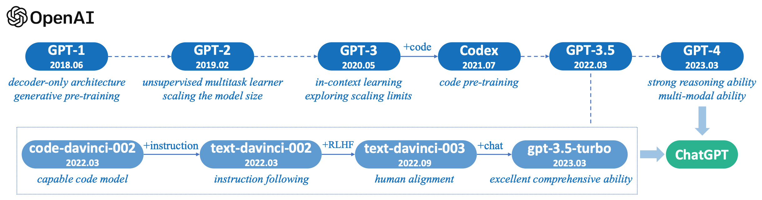
What does OpenAI offer?
Browser-based service:
ChatGPT and ChatGPT Plus
DALL-E
GPTs
API-based service:
Embeddings
Fine-tuning
Image generation
Vision
Text-to-speech (and speech-to-text)
Notes:
Web-based This is what most of us think of when we talk about OpenAI. These include the chat models: ChatGPT (3.5-turbo) and ChatGPT Plus (the paid version which includes GPT-4-Vision). OpenAI also has their flagship text-to-image model, DALL-E, and their text-to-speech (and the reverse) model, Whisper. In addition, OpenAI recently announced GPTs, a way for users to create their own versions of specific GPTs. These are versions of GPT which you can configure with custom prompts and augment with knowledge retrieval.
A sidenote on GPTs GPTs essentially appears to combine prompt engineering with RAG. You can define a specific prompt and a knowledge base to draw from.
API-based The OpenAI API is way to gain more fine-grained control over a wider range of LLMs. They give access to models with different context sizes, different capabilities, and give you access to things like controlling randomness, or not just returning the top next token, but perhaps the top-5 next tokens. The API allows you to integrate OpenAI models into web-applications, or other machine learning models. A key difference, is that you now no longer have this human labor bottleneck, whereby you must manually enter text into the web-browser. Instead, you can send very many requests to the models in a short amount of time. Different contextual windows.
Advantage and disadvantages ChatGPT is free to use. However, the more advanced capabilities are not free to use and will set you back 20USD/month. Users are also limited by interacting with a web-browser, and do not have control over things like temperature. The ChatGPT interface is generally very easy to use. With ChatGPT Plus, there is currently a freeze of new users, so if you didn’t already have an account before, then you have to go on a waitlist
The API is a kind of “pay-as-you-go” plan. You will pay for tokens sent to the model, as well as tokens output by the model. Cost per token ranges substantially between models, but sending many requests to GPT-4 will quickly outweigh the cost of a ChatGPT Plus subscription. The API gives you much more control, and allows you to do things you simply cannot do with the browser. However, there is a barrier to entry: you need to be able to code in python.
Performance differences The differences in performance between GPT-4 on the one hand and GPT-3.5 and other models in the other hand, is significant. We’ll move on to evaluation later, but for things like reasoning, theory of mind tests, coding, etc. Even in the case of translation for simple sentences, GPT-4 will perform very well. The fact that GPT-4 can translate at all, is astonishing. There is no model currently in existence, with the same ease of access that will perform better than GPT-4 on the widest range of tasks.

Slide 13
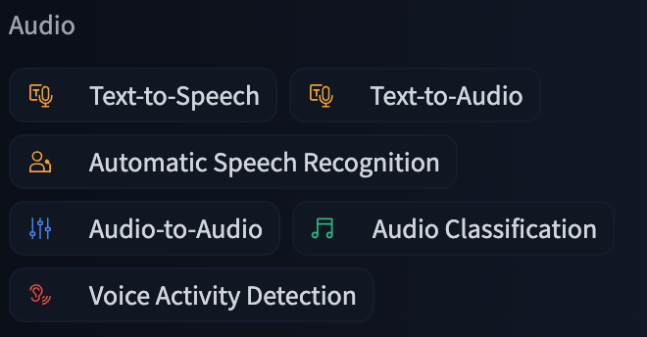
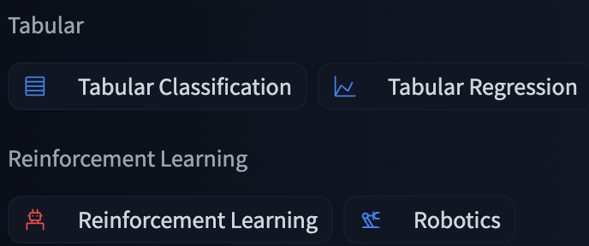

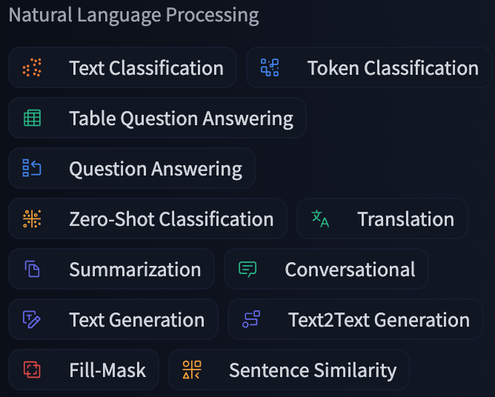
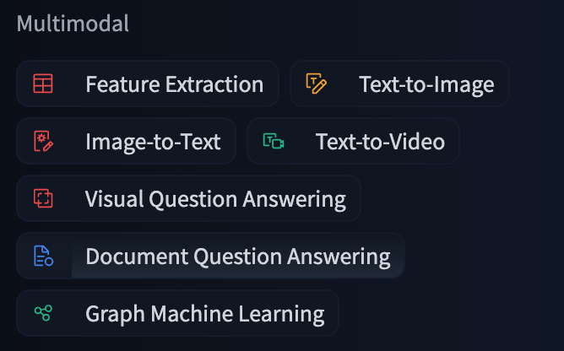
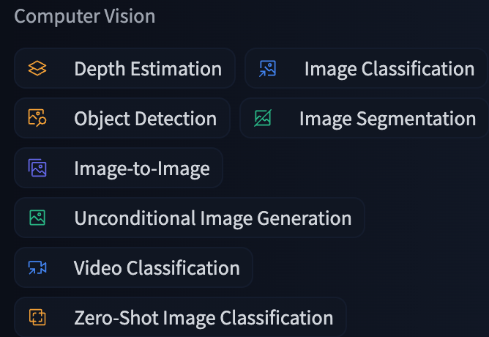
Open source LLMs
Notes:
Open source alternatives There are a significant number of open source alternatives to OpenAI products. To get a feel for how many: in only the category of Text Generation on the Hugging Face Model Hub, there are over 32k models available to download. So which ones are the best? The current best performing LLMs are Llama2 and Mixtral. Hugging Face has a leaderboard, which ranks LLMs based on a number of tasks. However, this leaderboard is open to anyone to submit models, and models that are trained to perform well on these tasks may not generalize to other tasks. In general it can be quite difficult to compare LLMs, because there is no agreed upon way to comprehensively evaluate them.
All of these models can be accessed on Hugging Face or downloaded from the developers directly (usually both options are available). You have the option to download the base pre-trained models in a number of different sizes, or access them via an API. The barrier to entry to use open source models is in some cases significantly higher than using closed source models with a mature API. How do you run OS models?
Local LLMs can require vast memory and compute resources. It is possible to locally run smaller models like BERT or nano-GPT on something like a Macbook M1. However, in order to use larger models, or even run smaller ones with low inference one, a high-end GPU is required with associated memory. Google Colab is one option, but you’re at the mercy of GPU availability, very limited memory, and the seemingly random nature of Colab connections.
If you have access to a GPU then you can download the model and weights locally via Hugging Face and interact with it using the transformers library.
Alternatively, you can use a cloud provider such as AWS, and some services such as AWS Sagemaker have some models for inference readily available. However, running inference on Llama2-7b (which is the smallest model available), will cost you about 1.50USD/hr if you leave it running!
Hugging Face does offer an API to run inference on models, but your access will be quite limited. There is the option of paying for Pro access which has higher rate limits.

Slide 14
But is it really open source…?
Here are some things to look out for:
Weights
Training data (and RL data)
Training code
License
Architecture
Preprint/paper
Modelcard
Package
API

Slide 15
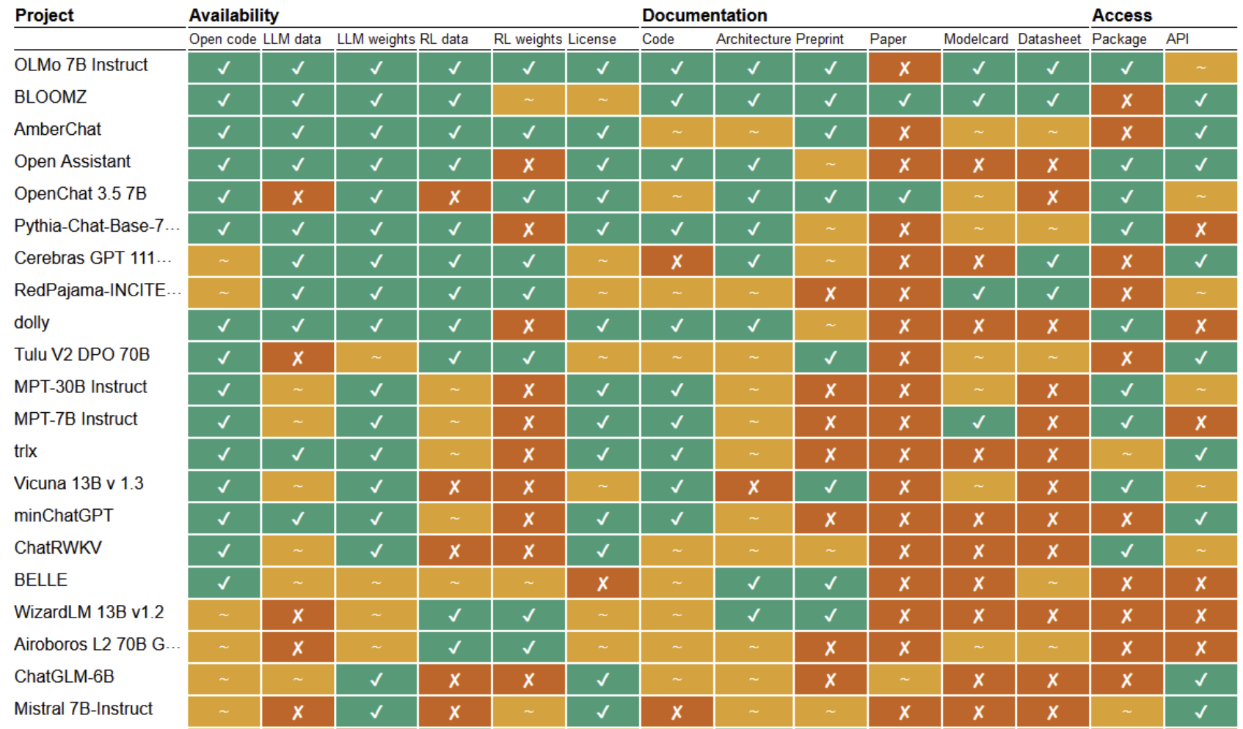

Slide 16
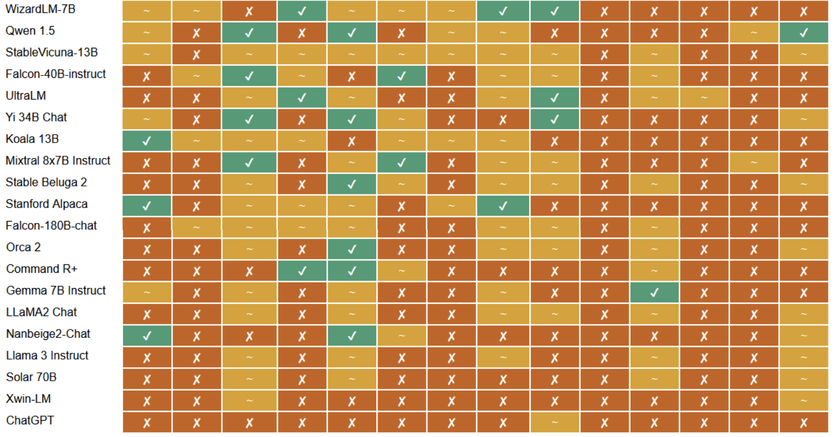
Liesenfeld, Andreas, and Mark Dingemanse. "Rethinking open source generative AI: open washing and the EU AI Act." The 2024 ACM Conference on Fairness, Accountability, and Transparency. 2024.

Slide 17
How can you run open source models?
There are two main ways to access open source models:
API
Huggingface Hub API
Individual company APIs
No compute required but restrictions on requests
Cloud
Google Colab
Commercial cloud providers are expensive
Steep learning curve
Locally
Code
No code
Requires compute…
Notes:
How do you run OS models?
In order to leverage the full power of an unquantized LLM, you need a graphics processing unit, or GPU. Your computer will have two types of computer in it – the CPU and the GPU. In a video game for example, the CPU is responsible for executing game logic, managing AI, some of the physics calculations, audio processing. The GPU is responsible for ensuring that your game looks amazing. Graphics rendering is essentially complicated linear algebra, so people have developed purpose built chips that are very good at linear algebra. And what is deep learning…? It is again, just complicated linear algebra.
Local LLMs can require vast memory and compute resources. It is possible to locally run smaller models like BERT or nano-GPT on something like a Macbook M1. However, in order to use larger models, or even run smaller ones with low inference latency, a high-end GPU is required with associated memory. Google Colab is one option, but you’re at the mercy of GPU availability, very limited memory, and the seemingly random nature of Colab connections.
If you have access to a GPU then you can download the model and weights locally via Hugging Face and interact with it using the transformers library.
Alternatively, you can use a cloud provider such as AWS, and some services such as AWS Sagemaker have some models for inference readily available. However, running inference on Llama2-7b (which is the smallest model available), will cost you about 1.50USD/hr if you leave it running!
Hugging Face does offer an API to run inference on models, but your access will be quite limited. There is the option of paying for Pro access which has higher rate limits.
Do you need to be able to code in order to interact with and train LLMs? What about hardware?
So how can you get access to a GPU?
- Google Colab
- Cloud
- Buy one
- Your departmental servers
- The HPC!

Slide 18
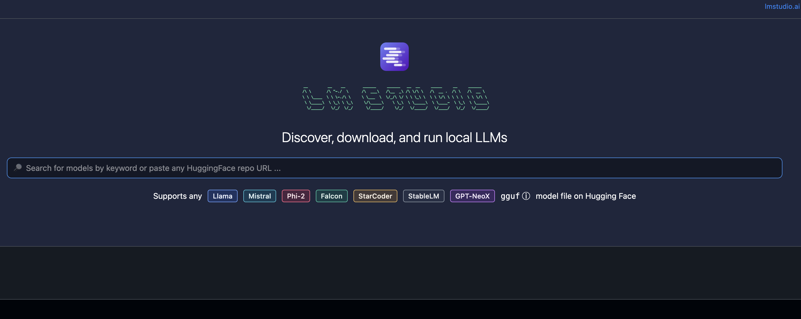
No code

Slide 19
No Code
Some no code options for running LLMs locally
LMStudio
Not open source
Desktop client
GPT4All
Open source desktop client
Upload documents for question answering
Bindings for Python and NodeJS, and LangChain itegration
Textgen-webui
Open source
Runs in the browser which means you can spin it up on a remote GPU
Requires some effort to install and run on Linux machines.
Ability to fine-tune models
Notes:
No code options vary in their complexity.

Slide 20
Resources
LMStudio
GPT4All
Textgen-webui
OpenAI API Usage, Pricing, and Policy
HuggingFace Tutorials
Notes:
.

Slide 21
How to keep up?
LinkedIn
OpenAI
Meta and AI at Meta
Hugging Face
Microsoft and Microsoft Research
Apple
PyTorch
YouTube
Fireship
Two Minute Papers
Joma Tech
Reddit
r/LocalLLaMA
r/MachineLearning and r/learnmachinelearning
r/OpenAI
Notes:
One thing that we get asked is: how am I supposed to keep up with all of these developments?
The simple answer is that you can’t. But once you have situated yourself in the landscape, it becomes easier to ignore the noise, and recognize the important things.
Here are some ways that I personally try and keep up to date with stuff, and it’s all fairly passive. So first, I changed my behaviour from scrolling through Instagram and Tik Tok, to scrolling through reddit and linkedin. And with this change you can passively stay up to date.
The first source is LinkedIn. Follow these pages and new developments will appear on your feed.
The second is YouTube. YouTube in general is filled with AI News channels, so there are probably very many more out there, but these are main ones that I use.
The third is Reddit. Reddit can be a great place to keep up to date with things. r/MachineLearning is heavily research focussed, and will have some non LLM stuff as well. r/learnmachinelearning is very much directed at beginners. r/OpenAI is obviously directed at OpenAI. And r/LocalLLaMA is mostly geared towards running models on your local machine, but much of the information there can be applied to using a remote server, or the HPC.
These sources come with a warning that using reddit exposes you to the potential of seeing and reading NSFW content.

